Slide 1
Automated Process Maps
PC Bots & Analytics Server

Slide 2



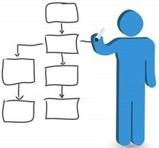
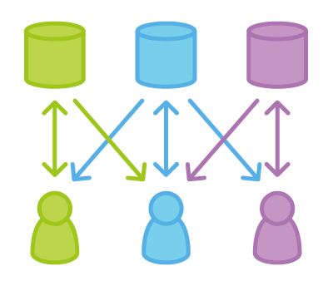
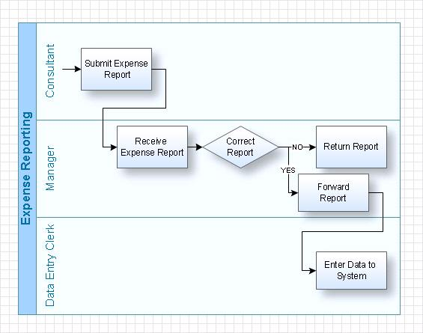
How it Works? Human action monitoring for creating processes & workflows.
PC Bot - Monitor mouse, keyboard and interaction with applications to map processes. Server - Apply machine learning at the backend for correlating person to person flow of work to map workflows.
Capture
Extract
Process
Workflow
View
PC Bot - @Team
Monitor mouse, keyboard and interaction with applications.
Server
Apply machine learning to create processes & workflows.
Graph wrapping technique for creating minimum number of optimal maps with if-conditions.

Slide 3
Step by Step : How it works? Step 1/4 – Setup Team & Staff

Slide 4
Step by Step : How it works? Step 2/4 – Review Mapping Status

Slide 5
Step by Step : How it works? Step 3/4 – Browse Workflows

Slide 6
Step by Step : How it works? Step 4/4 – Next Step(Fintech Revolution)

Slide 7
IT Environment – For 100 FTE Requires 4 linux servers & Windows OS for all staff
Bots
Windows x64 (7,8.1,10)
RAM – 512+ MB
Minimum dual core
Python virtual Env Or JVM
Web Server & Database Server
Ubuntu 14 LTS
RAM – 8 GB
Quad Core
HDD 1 TB (SAN prefab)
1 GBPS Line
Python 2
Oracle Java 8
Node.js
Analytics Server & Bot Controller
Ubuntu 14 LTS
RAM – 64 GB HF
6+ Core
HDD – 1 TB
Nvidia Geforce 980 – 8 GB
SSD – 256 GB
1 GBPS Line
Python 2
Oracle Java 8
Plug 'n Play
Configuration
Plug 'n Play
x100
Bots
x2
Host
Database
x2
Bot Socket
CV Classification

Slide 8


Enterprise – Data Privacy Control
Two sources of sensitive data
Typed by user – Stays in databases until analytics batch is run(30 mins to 10 Hours). Information is used to find type of data and then the texts are deleted from Database.
Screen capture – Stays in system until analytics batch is run(30 mins to 10 Hours). Information is used to find the decision making values/types from screen and then the images are deleted from Database.
Risk Remediation
Data is purged from databases after analytics (IN 30 mins. to 10 hours)
System clears cache every 24 hours
Except click & type locations nothing is stored.
Control Methods
Encrypted transport of data over sockets.
Encrypted storage in databases.

